Slide 1
Smart Brain App
Image Recognition Tool

Slide 2
Brief
Frontend – ReactJs, Tachyons, Flexbox, React Router.
Backend – NodeJs, ExpressJs, MongoDb.
Api – Clarifai, Face Detection Api.

Slide 3
Front End
ReactJs, Particles.Js, Tilt.js, Tachyons.js

Slide 4
React Components
1 – Navigation
2 – Logo
3 – Image Link Form
4 – Rank
5 – Face Recognition
6 – App

Slide 5
1 - Navigation
Type of Component – Functional Based Component.
State Used – No.
Functionality – Simply shows a navbar with Sign Out button.

Slide 6
2 - Logo
Type of Component – Functional Based Component.
State Used – No.
Functionality – Using Tilt.Js Library created a great animated logo. Image of Brain is kept as a Logo for the App.

Slide 7
3 – Image Link Form
Type of Component – Functional Based Component.
State Used – No.
Functionality – It binds the search form which contains input field and submit button.

Slide 8
4 – Rank
Type of Component – Functional Based Component.
State Used – No.
Functionality – To show the current rank of the User.

Slide 9
5 – Face Recognition
Type of Component – Functional Based Component.
State Used – No.
Functionality – To display the searched Image with detected faces.

Slide 10
6 – App
Type of Component – Class Based Component.
State Used – input(to store the searched term) and imageUrl(searched term updated after submission to fire api request).
Call Back Functions –
1 – onInputChange() – Every time the text input will change from ImageFormLink, it will hit the function call to set the state of input with the changed term.
2 – onSubmit() – Every time we submit the form, it will fire the Api call, for the imageUrl term.
Functionality – To binds the full React App’s Components

Slide 11
CSS
Clarifai, Face Detection API

Slide 12
1 – Tachyons
Font – f1->f6
Padding – pa0-pa7
Padding Horizontal – ph
Padding Vertical – pv
Margin – ma0-ma7
Margin Top – mt0-mt7
Width – w-10 (10%)
Hover – dim, glow, underline-hover, grow.
Dib
Link
White
Bg-light-purple

Slide 13
2 – Flexbox

Slide 14
Api
Clarifai, Face Detection API

Slide 15
Steps to Use Api
Step 1 – Install Clarifai <npm install clarifai>
Step 2 – Import Clarifai <import Clarifai from “clarifai”;>
Step 3 – Create the Instance of Clarifai
const app = new Clarifai.App({
apiKey: <api_key>});

Slide 16
Steps to Use Api
Step 4 – Calling an API
app.models.predict(Clarifai.FACE_DETECT_MODEL,<link_of_image>).then(
function(response) {
// do something with the response
},
function(err) {
// do something with the error
}
);

Slide 17
Back End
Image Recognition Tool

Slide 18
Database PostgreSQL
Image Recognition Tool

Slide 19
Command Line Commands
1 psql –U <username_postgres> – To run postgreSql terminal.
2 \c <database_name> - To select some specific db.
3 \d – To display all relations schema’s of the currently selected db.
4 \q – To quit from postgreSql terminal.

Slide 20
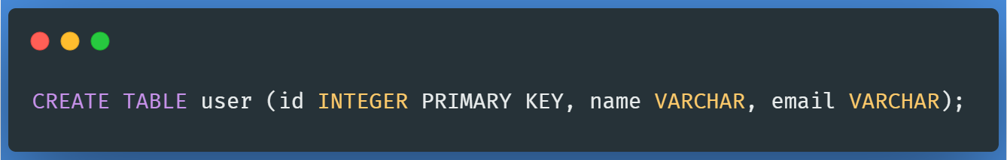
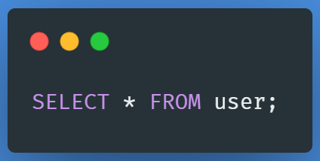
Creating New Table

Slide 21
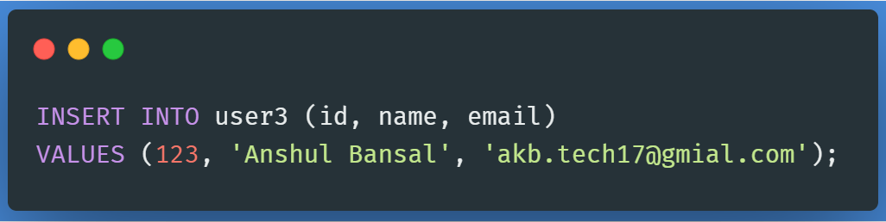
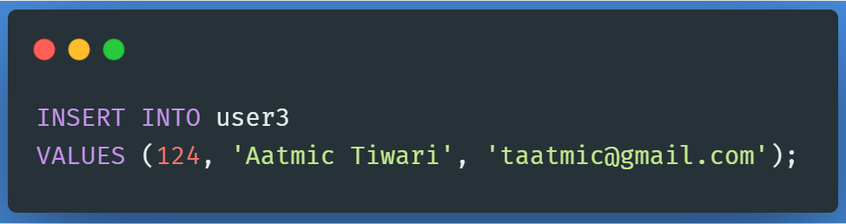
Inserting Values in Table

Slide 22
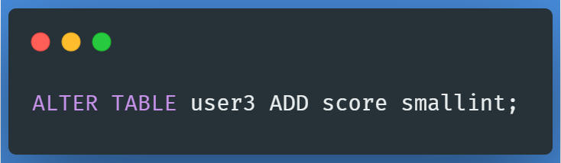
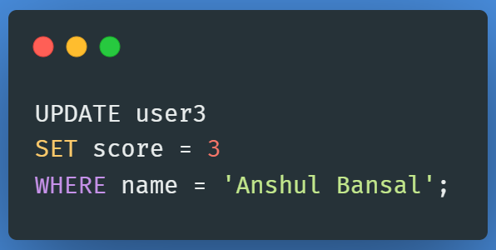
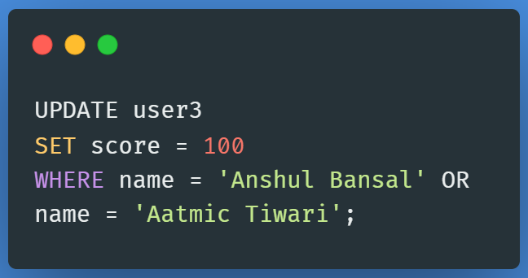
Alter and Update

Slide 23
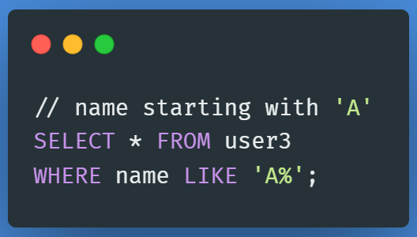
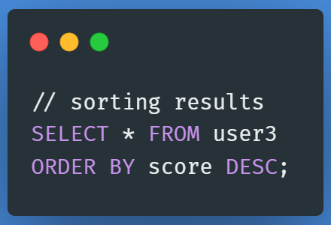
Conditional Sections

